Slide 1

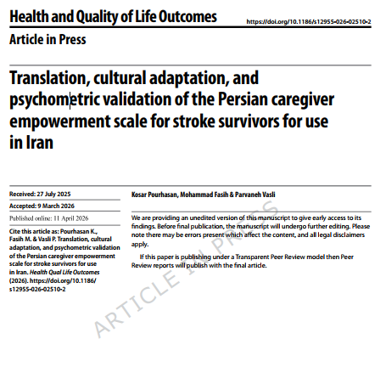


Slide 2
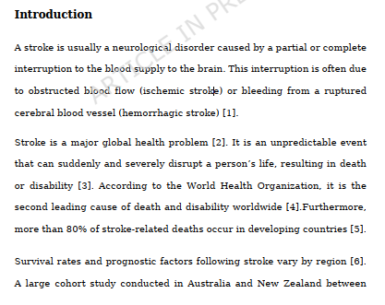
Translation, Cultural Adaptation, and Psychometric Validation of the Persian Caregiver Empowerment Scale for Stroke Survivors for Use in Iran

Slide 3
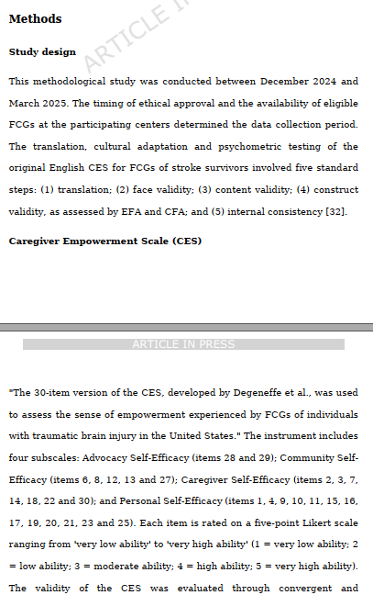
Translation, Cultural Adaptation, and Psychometric Validation of the Persian Caregiver Empowerment Scale for Stroke Survivors for Use in Iran

Slide 4
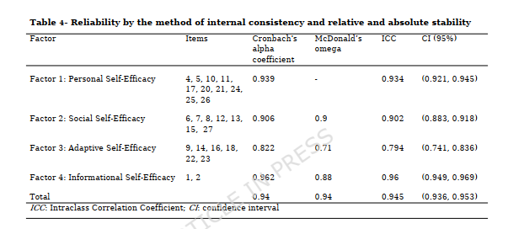
Translation, Cultural Adaptation, and Psychometric Validation of the Persian Caregiver Empowerment Scale for Stroke Survivors for Use in Iran

Slide 5
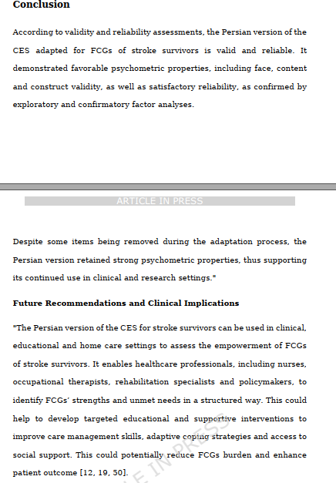
Translation, Cultural Adaptation, and Psychometric Validation of the Persian Caregiver Empowerment Scale for Stroke Survivors for Use in Iran

